Slide 1
ELECTRONIC STRUCTURE
Dr. Albert Aniagyei

Slide 2

Electronic Structure Path: Molecular or Quantum Mechanics
Molecular mechanics uses classical physics to simulate molecular systems, treating atoms as balls connected by springs (bonds).
It predicts molecular structures, properties, and dynamics by calculating the potential energy based on a force field, which models interactions like bond stretching, angle bending, and non-bonded forces.
This method is computationally efficient and is used to study large molecules and their interactions, though it is not accurate for reactions involving breaking covalent bonds unless a reactive force field is used

Slide 3
Limitations of MM
Bond breaking – Standard force fields are not accurate for reaction that involves breaking or forming covalent bonds.
Accuracy – The accuracy of the results depends on the quality of the force field and its parameters, which are derived from experimental or high-level quantum mechanical calculations.
Quantum Effects – It does not account for quantum mechanical effects like electron delocalisation, which are important in certain chemical reactions

Slide 4
Why are they Important?
Electronic structure calculations use a quantum mechanical description of a system, which can, in principle, provide insight into additional observables that are not accessible to classical forcefield approaches, such as optical, electronic and magnetic properties.
The size of porous organic molecules, frequently more than 100 atoms for intrinsically porous molecules, means that high-level wavefunction methods are too computationally expensive in most cases, and hence most electronic structure calculations for such molecules have applied Density Functional Theory (DFT)
Jelfs, K. M., Cooper, A. I., Molecular simulations to understand and to design porous organic molecules, Current Opinion in Solid State and Materials Science, 17, 1, 2013

Slide 5
These methods are essential for understanding chemical properties, predicting molecular structures and calculating reaction energies, reaction mechanisms and atomization energies
Many interesting material properties, such as magnetism and superconductivity, depend on the material’s electronic structure as given by the ground-state wavefunction.
The wavefunction may, in principle, be found by solving the time-independent Schrödinger equation, but doing so with sufficient accuracy is challenging because computational cost grows dramatically with the number of particles
Gerard, L., Scherbela, M., Sutterud, H, et al, Transferable Neural Wavefunctions for Solid, Nat Comput Sci (2025)

Slide 6
The challenge is particularly pronounced in solid state physics, where accurate calculations for periodic systems require the use of large supercells, and consequently, many particles minimise finite-size effects
They require approximations for electron interactions, which limit accuracy and increase computational cost
Gerard, L., Scherbela, M., Sutterud, H, et al, Transferable Neural Wavefunctions for Solid, Nat Comput Sci (2025)

Slide 7
ELECTRONIC STRUCTURE METHODS

Slide 8
Hartree-Fock Method (HF)
The Hartree-Fock method is a computational approach used in quantum chemistry to approximate the wave function and energy of a many-electron system.
This method relies on the principle of self-consistent field (SCF) theory, where the effects of electron-electron interactions are simplified by assuming that each electron moves in an average field created by all other electrons.
This is foundational in computational chemistry, providing a framework for understanding molecular behaviour and facilitating further advancements in molecular modelling.

Slide 9
Limitations
While Hartree-Fock can provide valuable insights, it often underestimates electron correlation effects, leading to less accurate results for certain properties compared to more advanced methods.
Electronic correlation is the interaction between electrons in the electronic structure of a quantum system. The correlation energy is a measure of how much the movement of one electron is influenced by the presence of all other electrons.

Slide 10
Post Hartree-Fock Methods
All post-HF methods have the goal of capturing the part of electron correlation missing in the original HF formulation.
This can be done principally in two ways. One way tries to correct the single determinant approximation, and the other tries to introduce correlation energy through perturbation theory.
The most popular post-HF methods that are utilised in modern quantum chemical program packages are based on various flavours of the CI approach, or Møller–Plesset (MP) perturbation theory.

Slide 11
Limitations
Since MP is perturbative and not a variational approach, it is not known if the energy is lower or higher than the exact one.
The most important sources of problems are the systems where the electron correlation is too large, and the perturbative approach becomes questionable.
Thus, MP methods tend to produce poor results for spin-state energetics in TM compounds.

Slide 12
All post-HF methods share a common limitation of a strong basis set dependence.
It is commonly found that the use of improved methods requires a larger basis set, further increasing the cost of calculation.
Another disadvantage of these methods is poor scaling with the system size. This restricts the usage of these methods to systems of relatively modest size

Slide 13
Density Functional Theory (DFT)
DFT is considered an exact theory in principle because the Hohenberg-Kohn theorems prove that the ground-state energy and other ground-state properties of a system are uniquely determined by its ground-state electron density.
The first theorem states that the ground-state properties of a many-electron system are uniquely determined by the electron density.
The second theorem proves that the exact ground-state energy is the minimum value of a functional of the electron density, which can be found using a variational principle.

Slide 14
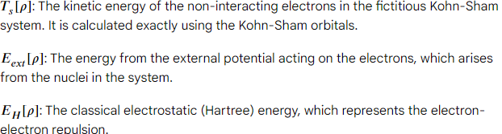
The KS-DFT method expresses the total electronic energy (E) as a functional of the electron density, incorporating four main terms

Slide 15
The exchange-correlation energy. This crucial term contains all the unknown complexities of the real, interacting system, including quantum effects like exchange and correlation. In practice, this term must be approximated

Slide 16
This means that if the exact functional (a mathematical expression for the energy based on the density) were known, the theory would give an exact solution for any system.
The practical difficulty is that the exact functional is not known, so approximations must be used; this is why the practical implementation is often referred to as a density-functional approximation (DFA).

Slide 17
Density functional theory (DFT) has achieved great success in chemistry and physics, due in large part to improvements in the necessarily approximate exchange–correlation functionals.
In modern exchange–correlation functionals, the electronic energy per unit volume may depend on several properties or functionals of the electron density, both local (for example, spin densities, their gradients, and local spin kinetic energy densities) and nonlocal (such as Hartree–Fock exchange).
Perdew, J. P. Phys. Rev. B 1986, 33, 8822– 8824

Slide 18
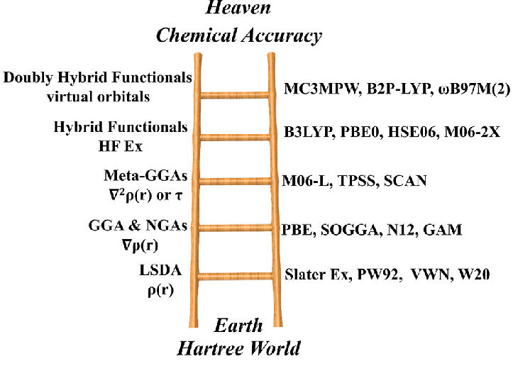
Most functionals, depending on only the spin densities and their gradients, are so-called generalised gradient approximations (GGAs).
Adding dependence on the local spin kinetic energy densities yields meta-GGAs.
Adding dependence on Hartree–Fock exchange yields hybrid functionals (which are sometimes also called hyper-GGA)
Adding a dependence on unoccupied orbitals yields fifth-rung functionals
Perdew, J. P.; Schmidt, K. AIP Conf. Proc. 2001, 577, 1– 202

Slide 19
Nevertheless, there is considerable interest in functionals that depend only on the spin densities and their gradients.
Fabiano et al., summarized “The majority of practical DFT applications are based on GGAs and hybrid functionals, which provide the best compromise between accuracy and computational effort.
GGA functionals provide an efficient tool for studying large systems (e.g., in biology and solid-state physics) and still outperform hybrid functionals for organometallic and transition metal complexes.
In addition, they attract basic theoretical interest because they constitute the basis on which meta-GGA, hyper-GGA, and hybrid functionals are constructed
Fabiano, E.; Constantin, L. A.; Della Sala, F. J. Chem. Theory Comput. 2011, 7, 3548– 35593

Slide 20
Limitations
Self-interaction error (SIE) is one of the major sources of error in most approximate exchange-correlation functionals for Kohn–Sham density-functional theory (KS-DFT)
It is large with all local exchange-correlation functionals and with some hybrid functionals.
SIE is an error in density functional approximations (DFAs) where an electron incorrectly interacts with itself through the Coulomb and exchange-correlation potentials.
This leads to inaccurate results in calculations, particularly with electron removal energies, molecular dissociation energies, and the prediction of transition states.

Slide 21
The exact form of the exchange-correlation functional is unknown, and the accuracy of the results depends entirely on the chosen approximation.
Can struggle with systems that involve strong electron correlation or van der Waals forces, although newer functionals address these issues with varying success.
Note that solid-state physicists are often more interested in lattice constants than in cohesive energies, and chemists are often looking more for improved performance on energies than on structural parameters

Slide 22
BASIS SETS
In electronic structure calculations, a basis set is a set of mathematical functions, typically atomic orbitals, used to create molecular orbitals.
By combining these functions in a linear combination, the electronic structure of a molecule can be approximated, providing a way to solve the Schrödinger equation.
The choice of basis set is crucial as it determines the accuracy of the calculation, with more complex sets offering higher precision but at a greater computational cost.

Slide 23
KEY CONCEPTS
LCAO-MO: The principle that molecular orbitals are formed by combining atomic orbitals
BASIS FUNCTION: The fundamental one-electron functions (e.g., s, p, d) that form the basis set
Gaussian-Type Orbitals (GTO): The most common type of basis function used today due to their computational efficiency
Slater-Type Orbitals(STO): A type of orbital that more closely resembles true atomic orbitals but is computationally more expensive. GTOs are often used to approximate STOs

Slide 24
TYPES OF BASIS SETS
Minimal basis sets: Use the minimum number of atomic orbitals required to describe the electrons in a molecule (e.g. one s function and three p functions for the second-row atoms)
Split-valence basis sets: Use multiple basis functions for the valence (outer) electrons, allowing for a better description of chemical bonding.
Double-Zeta (DZ):Uses two different basis function for each atomic orbital, allowing for more flexibility
Triple-Zeta (TZ):Uses three functions for each atomic orbital.
Extended Sets: A broader category that includes basis set with polarization and/or diffuse functions, such as cc-pVDZ or aug-cc-pVDZ

Slide 25
Plane Waves: Used frequently for calculations on periodic systems like solids
Polarisation functions: Function with higher angular momentum than needed to describe the ground state atom(e.g., d functions for first-row atoms). They are important for accurately describing molecular geometries and chemical bonding
Diffuse functions: Include functions with a large spatial extent to improve the description of electrons that are far from the nucleus, which is important for anions, excited states, and intermolecular interactions.

Slide 26
Polarization Functions
These are functions with a higher angular momentum than is needed for the ground state of an isolated atom (e.g., adding p-functions to hydrogen or d-functions to carbon).
They allow orbitals to become asymmetrical, which is crucial for accurately describing chemical bonding and charge polarisation in molecules.
In Pople notation, an asterisk (*) indicates polarisation functions on heavy (non-hydrogen) atoms, while a double asterisk (**) adds them to all atoms, including hydrogen

Slide 27
Diffuse Function
These are large Gaussian functions with small exponents that decay slowly far from the nucleus.
They are essential for modeling anions, weak interactions like hydrogen bonding, and properties that depend on the electron distribution far from the nucleus, such as polarizability.
In Pople notation, a plus sign (+) indicates diffuse functions on heavy atoms, and a double plus (++) indicates them on all atoms. The prefix aug- serves the same purpose in Dunning sets.

Slide 28
Basis Set Hierarchies
Basis sets are organised into hierarchies that offer a trade-off between computational cost and accuracy.
Pople-style basis sets
Developed by John Pople, these Gaussian-based sets use a notation like N-MPG, where:
N: Number of primitive (uncontracted) Gaussians used to represent each core-shell orbital.
M, P: Number of primitive Gaussians used to represent the valence orbitals, which are "split" into inner (more compact, M primitives) and outer (more diffuse, P primitives) regions.
G: Denotes Gaussian functions.

Slide 29
Examples
STO-3G: A minimal basis set that uses three Gaussian primitives to approximate a single Slater-type orbital for each atomic orbital. It is computationally cheap but has low accuracy.
3-21G: A split-valence basis set. It uses three Gaussians for core orbitals and splits the valence orbitals into two functions, with two and one Gaussian primitives, respectively.
6-31G: A more accurate split-valence set that uses six Gaussians for core orbitals and splits the valence orbitals into inner (three Gaussians) and outer (one Gaussian) parts

Slide 30
Dunning-style (correlation-consistent) basis sets
These are designed to systematically approach the "complete basis set limit" for correlated wave function calculations.
cc-pVXZ: The notation for these basis sets, where X indicates the zeta quality (D=double, T=triple, Q=quadruple, etc.) and V signifies that the core orbitals are single-zeta while valence orbitals are multi-zeta.
Aug-cc-pVXZ: The 'aug' prefix indicates that diffuse functions have been added to the cc-pVXZ set.

